Slide 1
POLICE BRUTALITY
In the state of California

Slide 2
INTRODUCTION
Police brutality is defined as violation of civil rights where police officers use excessive force against civilians(Lawrence,2000).
Police brutality can be caused with certain differences that exist between citizens and the police officers (Lawrence,2000). Such differences include;
      Race
      Religion
      Political differences
      Socio economic status
      Cultural differences
According to Lawrence(2000), there are major types of police brutality such as:
      Unwarranted searches
      Corruption
      Racial profiling
      False arrest
      False imprisonment

Slide 3
Effects of police Brutality
In Oakland California most black people fall victim of police brutality as they are stereotyped as dangerous people and are associated with criminal activities (Holmes,2000).
Due to such stereo types made by the society people of color in California are now a easy target of police more than the white people.
This brutality has led to several killings of innocent civilians both black and white and including young boys and men (Holmes,2000).
Police brutality has increase the rates of false arrests and arrest of innocent people.
Obstruction of justice and false evidence provided by the police officers have also incriminated citizens for crimes that they did not commit.
The police officers who are supposed to keep the city safe are now making the streets unsafe for people because of police brutality and violence that has instilled fear on many citizens of California (Holmes,2000).
Corruption also which is a silent form of police violence has corrupted the justice system and causing people to be unfairly judged in courts and sentenced harshly if they do not offer bribes (Holmes,2000).

Slide 4
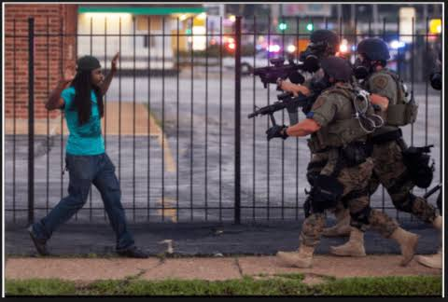
Evidence of Police Brutality
It is evident that police brutality in the state of California happens even during the day where innocent civilians are harassed and held at gunpoint by police officers .Majority of the victims end up falsely arrested and charged with crimes that they are not associated with(Rodríguez,2012).
The image on he right shows a black man being held at gun point with several policeman on the streets during the day.
It is even inhuman how four heavily armed police officers attack one single unharmed innocent civilian and they use unwanted force on the victim without hearing their perspective and understanding how they feel.
Such police officers react to situations inappropriately without understanding what is going on at a certain time
Source :www.youthvoices.live

Slide 5
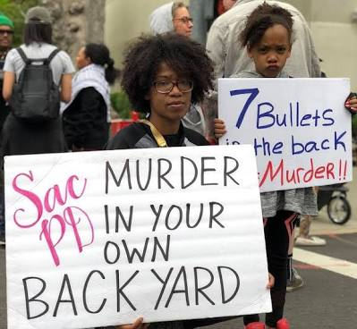
Evidence of police brutality
Police brutality in California is a huge problem that needs to be curbed. Residents of Oakland took to the streets protesting about how their neighborhoods are unsafe including their own backyards because of merciless and brutal killings cased by policemen and gun shootings.
From the picture we can see demonstration of people carrying banners written hurtful messages that they are trying to air out their pain , disappointment and worry in how unsafe their own homes are currently because of police violence.
Source: newsandletters.org

Slide 6
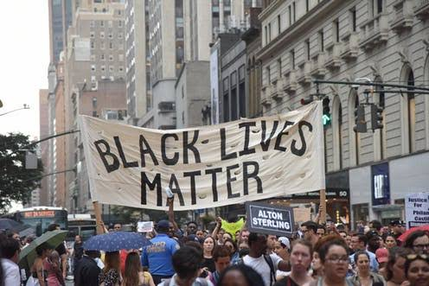
Evidence of police Brutality
The Black Lives Matter activist movement took to the streets to protest against police killings of black men and other broader issues such as racial inequality and racial profiling (Rodríguez,2012).
The picture on the right is an evidence of how the people of California are tired of being oppressed and violated by police violence and they hold peaceful demonstrations to show their grievances and try to pass a message to the public and to the police that regardless of race every person is important and that black lives matter.
Source: blacklivesmatter.com

Slide 7
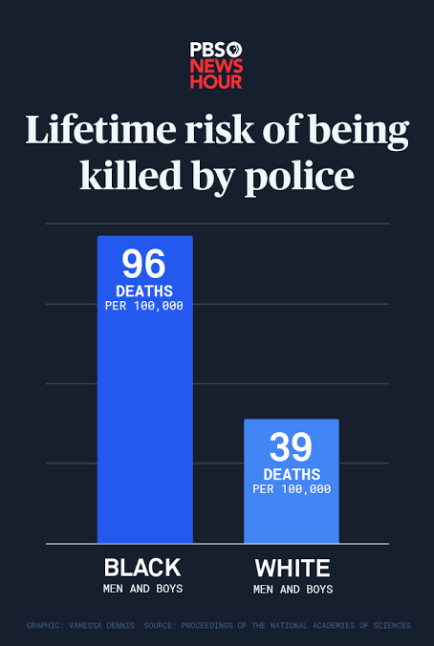
Evidence of police brutality
In California most of the police brutality victims are people of color and specifically men and boys. This assumption is proved by the statistics provided by PBSO News Hour as shows by the figure on the right side.
From this figure we see that 96 % of deaths per 100,000 population are of black men and boys caused by police brutality and violence.
Also 39% of deaths per 100,000 population of white men and boys are caused by police brutality and violence.
Source: injusticewatch.org

Slide 8
Sensitivity Training
This is a group training method which focuses at helping the members develop awareness of their work dynamics and their roles at work.
This training ensures that everyone in the workplace is treated with respect regardless of their class, race or religion.
To curb and reduce police brutality, police officers should undergo sensitivity training so that they learn how to handle civilians appropriately with respects regardless of who they are.
The police officers will also learn to consider the perspective of others especially the civilians to avoid false arrest and false imprisonment occurrences.

Slide 9
Cont’d
Sensitivity training will allow police officers to understand the sensitivity of civilians and learn how to deal with them appropriately as opposed to violence and brutality.
It is also n effective way to help the police officers to recognize and respond to bias in a way that doe not influence their decisions while at work and this will help them work well alongside people especially the civil society.
There are certain ways that police departments in California can implement the sensitivity trainings and these include:
    Making sure the leaders lead by setting good example
    Setting clear expectations from the police while in their line of duty
    Keeping people accountable for their actions

Slide 10
Cont’d
    Examining the behavior of the police officers both at work and off-work
    Teaching the officers communication filters to avoid verbal harassments of civilian
  From the evidences provided above ,it is clear that police brutality should be rectified in the state of California and that these sensitivity trainings should be mandated by the California state government. This will help mold and correct the mental state of police officers as well as increasing their awareness on sensitive issues when they are around the civilians and this will help them act on clear insights as opposed to reacting to situations without a clear understanding.

Slide 11
References
Charles, D., Himmelstein, K., Keenan, W., Barcelo, N., & White Coats for Black Lives National Working Group. (2015). White coats for black lives: medical students responding to racism and police brutality. Journal of urban health, 92(6), 1007-1010.
Holmes, M. D. (2000). Minority threat and police brutality: Determinants of civil rights criminal complaints in US municipalities. Criminology, 38(2), 343-368
Lawrence, R. G. (2000). The politics of force: Media and the construction of police brutality. Univ of California Press
Rodríguez, D. (2012). De-provincialising police violence: on the recent events at UC Davis. Race & Class, 54(1), 99-109.
Rodríguez, D. (2012). Beyond" Police Brutality": Racist State Violence and the University of California. American Quarterly, 64(2), 301-313.

